Slide 1

Healthy Behavior Challenge
CSCE 606 Software Engineering
Instructor : Prof. Philip Ritchey
Client: Prof. S. Niki Ritchey
GROUP MEMBERS:
Faizan Khaji
Satya Bhavsar
Sharvani Ramineni
Shweta Sharma
Utsav Dabhi
Vineet Gandham

Slide 2
What is HBC?
Healthy Behavior Challenge is a web-application for a challenge-based training platform.
The application is aimed at connecting two primary types of users -
Instructors and Trainees
The main role of Instructor is to create, manage and oversee challenges.
While trainees manage and monitor daily todo list tasks.

Slide 3
Roles: Instructors and Trainees
Trainee
Participate in personalized fitness challenges.
Manage and complete daily tasks for fitness progress.
Track individual achievements and challenge-wide successes.
Notes:
Trainees participate in personalized fitness challenges designed by instructors.
They manage and complete daily tasks, contributing to their overall fitness progress.
Trainees actively track individual achievements and challenge-wide successes.

Slide 4
Roles: Instructors and Trainees
Instructor
Create personalized fitness challenges for individual needs.
Curate daily task lists for a tailored fitness journey.
Monitor trainee progress and provide timely support.
Notes:
Instructors create and oversee fitness challenges tailored to individual needs.
They curate daily task lists, ensuring a personalized and effective fitness journey for each trainee.
Instructors closely monitor and track trainee progress, offering support and guidance when needed.

Slide 5
Why HBC is needed?
HBC can be used for fostering an engaging and effective fitness routine.
Its versatile applications span across diverse domains
Gym and Fitness Centers
Corporate Wellness Programs
Online Fitness Platforms
Health and Wellness Apps
Personal Trainers and Coaches
Educational Institutions
Notes:
Gym and Fitness Centers: Elevate the fitness experience by enabling instructors to seamlessly organize challenges, monitor trainee progress, and tailor workout routines for optimal results.
Corporate Wellness Programs: Foster a culture of well-being within organizations by engaging employees in health challenges, promoting team cohesion, and enhancing overall workplace fitness.
Online Fitness Platforms: Transform virtual fitness spaces with interactive challenges, personalized task management, and real-time progress tracking, creating a vibrant and motivating online community.
Health and Wellness Apps: Integrate HBC features into existing health apps to offer users a comprehensive wellness solution, encompassing tailored challenges, task management, and performance analytics.
Personal Trainers and Coaches: Empower trainers to curate specialized challenges, closely monitor trainee adherence, and provide targeted guidance, enhancing the effectiveness of personalized fitness programs.
Educational Institutions: Promote student well-being by incorporating fitness challenges into educational platforms, fostering healthy habits, and encouraging a holistic approach to physical fitness.

Slide 6
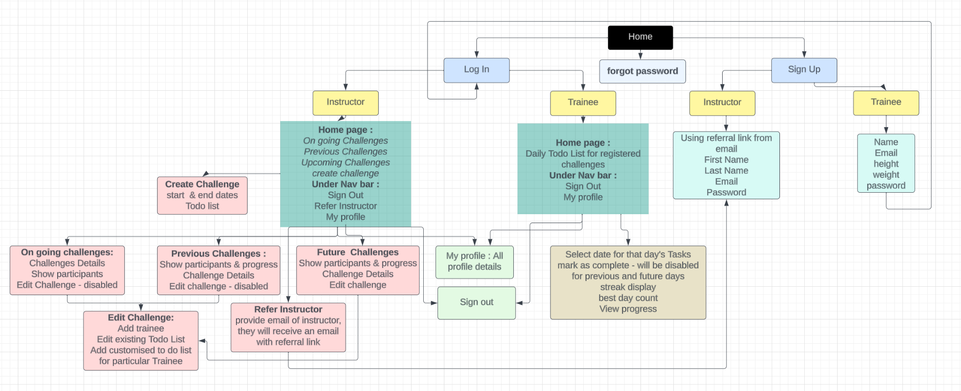
Application Flow

Slide 7
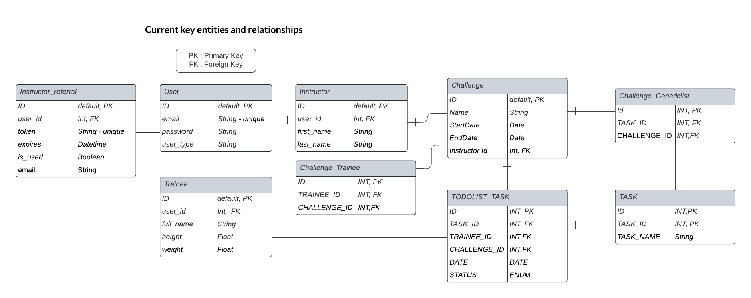
Design

Slide 8
Challenges faced
Our initial Heroku deployment brought unexpected challenges
Defining models became intricate due to associations among multiple tables
Resolving time zone issues from the Trainee's perspective posed challenges
Navigating the setup of the database for the test and development environment presented early challenges
Shifting to Test-Driven Development (TDD) and Behavior-Driven Development (BDD) presented a learning curve

Slide 9
Our Learnings!
Agile iterations emphasized early feedback, guiding us in adjusting to evolving client expectations.
Agile's incremental sprints taught us the value of continuous improvement, adapting our processes based on real-time experiences.
TDD and BDD implementation underscored the importance of crafting resilient, well-tested code.
Pair programming simplified debugging and accelerated collaborative problem-solving.

Slide 10
Our Learnings!
Code reviews on Github became a crucial lesson in early mistake detection and bug prevention.
Automated build and deployment processes saved time, offering a reliable safeguard against errors.
Using Project Management tool (Pivotal) helped in efficient organization, requirement tracking, and task distribution.
Code coverage reports highlighted the need for comprehensive code scrutiny, ensuring robust software.

Slide 11
Thank You !

